Slide 1
An Analysis of WAR as a Team Stat in the MLB
Anthony Capasso

Slide 2

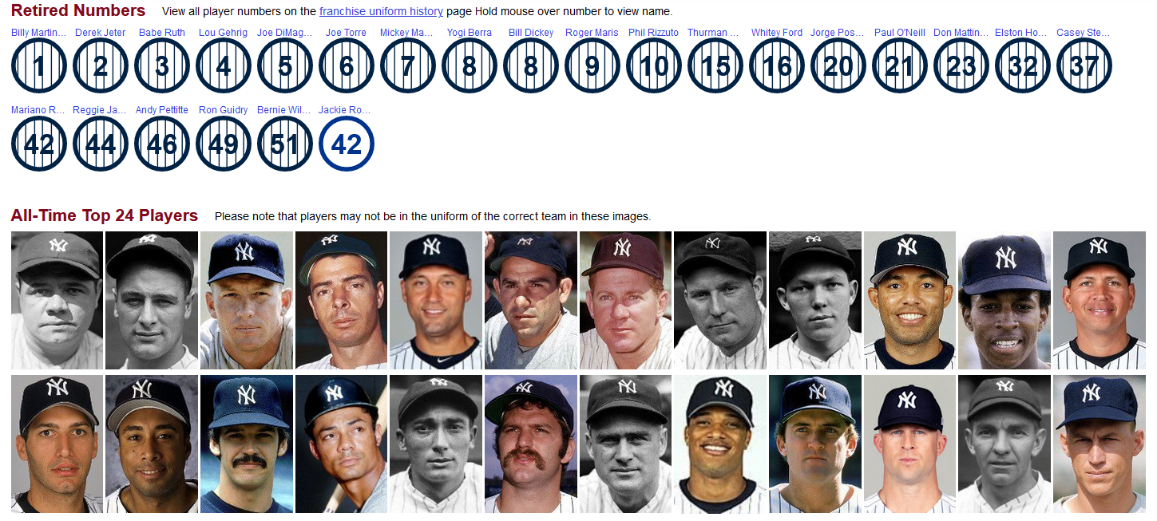
Wins above Replacement, often called WAR for short, has become the ultimate measurement of individual skill in Baseball over the past decade, as the MLB has invested in more advanced stat tracking. WAR claims to be the most complete measure of a player by using a variety of factors to compare each player to a theoretical league-average player.
Equation to calculate WAR:
(For position player)
In fact, WAR has become so ubiquitous in the baseball community that it’s used to retroactively rate players who died decades before it was created.
On right: Baseball Reference’s top 24 players in New York Yankees franchise history, ranked by WAR.

Slide 3
For this presentation I will be trying to analyze the effectiveness of WAR as a measure of total team success, by finding support for a relationship between total team WAR, regular season wins, and postseason wins.

Slide 4
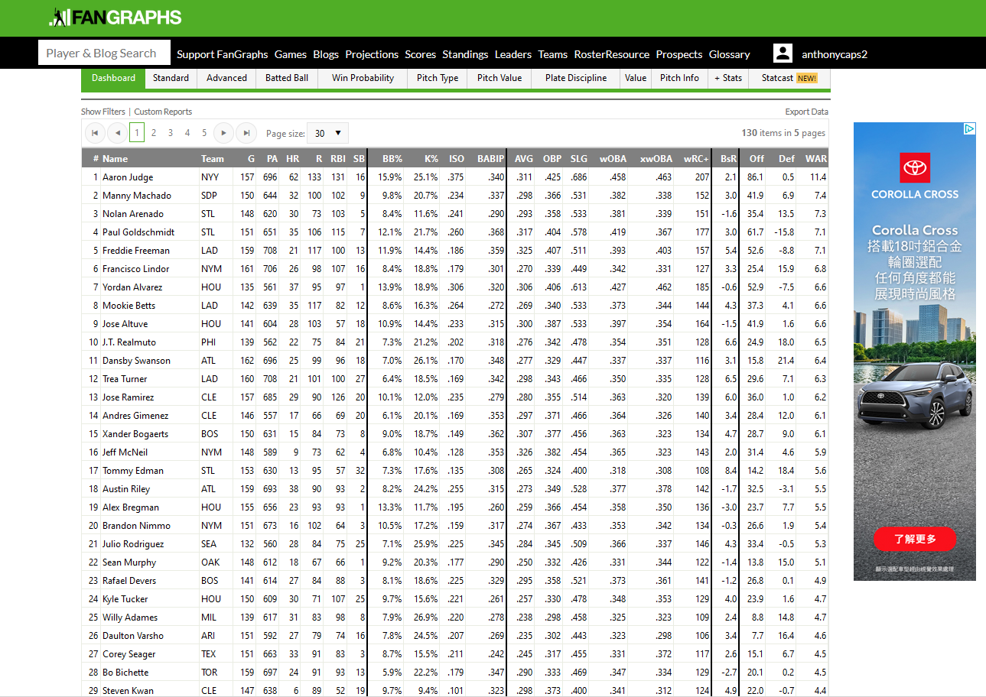
Data Sources
I used the fangraphs custom leaderboard in order to create a dataset with custom variables chosen from Fangraphs variety of Baseball stats (https://www.fangraphs.com/leaders.aspx?pos=all&stats=bat&lg=all&qual=y&type=8&season=2022&month=0&season1=2022&ind=0).
These stats included important things to analyze such as Team, Age, and WAR for each player.
Once I changed the settings to include more players from the 2022 season I was able to get the stats of 611 position players during the 2022 season.
I also used the MLB website (https://www.espn.com/mlb/standings) to get the number of wins in the regular season and in the playoffs.

Slide 5
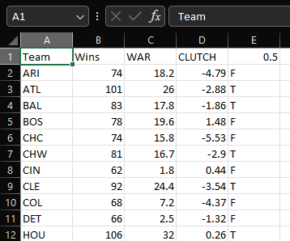
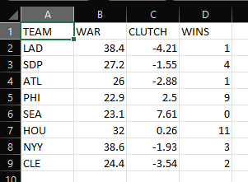
Derived Data
Dataset for teams taken from the individual stats and manually put into this sheet.
Dataset for playoff teams that was made by taking the regular season total WAR and Clutch from the regular season dataset and added the number of games each team won in the playoffs.

Slide 6
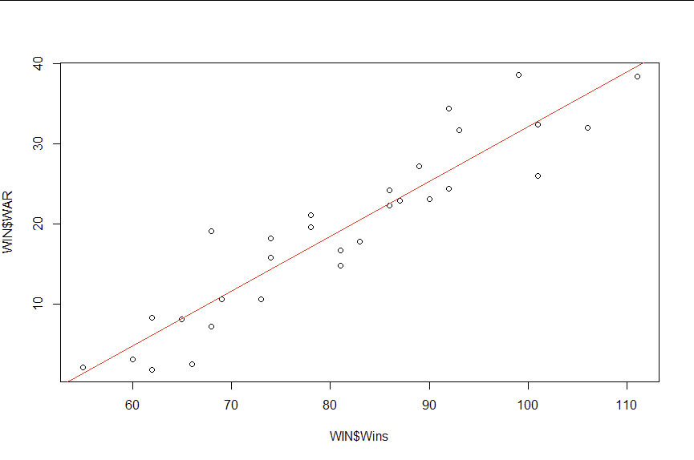
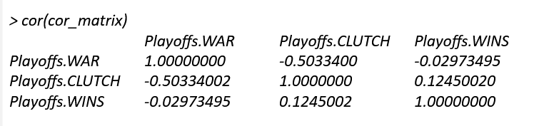
What is it Good For?
Using the graph we can see that there is a strong positive correlation between total team WAR and number of regular season wins.
Using the correlation matrix we can see that there is actually a negative correlation between regular season WAR and playoffs wins.

Slide 7
Findings
We found that our expected positive relationship of team WAR and regular season wins in 2022 is statistically significant.
We also surprisingly found that this trend is reversed in the 2022 postseason where team WAR had a slight negative correlation with playoff wins.
Our findings for this research show that WAR is a good way to measure team success during the regular season, but that WAR (and in turn regular season success) don’t correlate with postseason success.
One shortcoming of this analysis is that it only looks at data from the 2022 regular season and playoffs, meaning that we only prove these relationships during the 2022 season.

Slide 8
Special Thanks
Data Researcher - Me
R programmer - Myself
Writer - I

